Slide 1

Google Play Store App Popularity Analysis & Prediction
ECE 143 (FA25) Project: Group 5
Abdumannon Yovkochov, Aditi Pagey, Ke Liu, Shaurya Chopra, Zijun Zhang December 5, 2025

Slide 2
Agenda
About the dataset
Cleanup
Dataset Analysis deep dive
Prediction Model
Conclusion

Slide 3
Agenda
About the dataset
Cleanup
Dataset Analysis deep dive
Prediction Model
Conclusion

Slide 4

About the Dataset
L. Gupta, "Google Play Store Apps," Feb 2019. [Online] https://www.kaggle.com/lava18/google-play-store-apps
googleplaystore.csv:
list of apps, with various features - category, rating, #reviews, size, price, content rating, last updated, android version, and #installs
#installs is our ‘target’ variable
googleplaystore_user_reviews.csv:
user review texts, sentiment scores, sentiment subjectivity scores

Slide 5
Why care about no. of installs?
How much money an app makes is directly related to the number of installs
Marketers wish to know what makes an app ‘successful’
is it better to make an app free or paid?
does having 5 stars make an app successful?
whom should you target your app to?
does it matter how many reviews an app has? what kind of reviews?
…

Slide 6
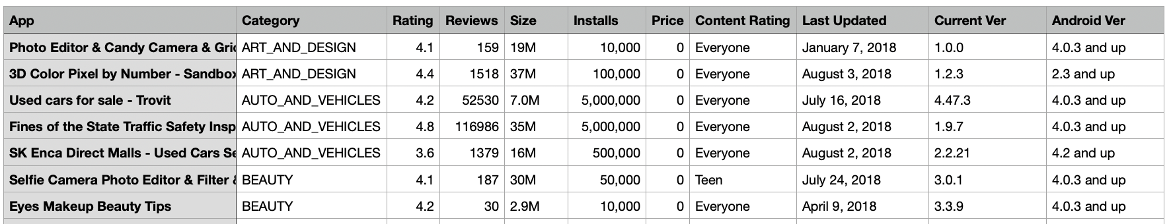
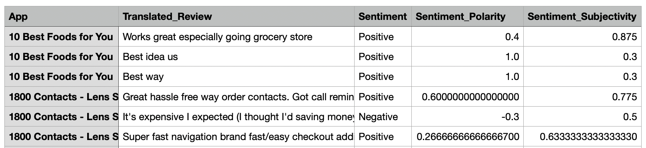
What does our dataset look like?

Slide 7
Agenda
About the dataset
Cleanup
Dataset Analysis deep dive
Prediction Model
Conclusion

Slide 8
Dataset Cleanup
googleplaystore.csv cleanup:
Remove exact duplicate rows.
For apps with the same name, keep the newest by Last Updated. If dates are the same, keep the one with more Reviews. If both dates are missing, keep the first one seen.
Force Rating to be between 0 and 5. Clean Installs by removing commas and plus, then convert to an integer
Clean Price by turning Free into 0, remove the dollar sign, then convert to a number.
Converted the app size to MB ,filled missing values using the median.
Bucketed Android Ver columns into integer ranges.
googleplaystore_user_reviews.csv:
Normalize all of the columns by removing leading/trailing spaces from all string columns
Converts "Sentiment_Polarity" and "Sentiment_Subjectivity" columns to numeric, coercing invalid values to NaN.
Count number of NaN’s and number of reviews for each app
Merge all of the comments to one row for each app by separating them with “|” sign
Calculate the percentage of positive reviews, mean, median and std of the polarity and subjectivity
Notes:
skip during presentation, but leave here for completeness

Slide 9
Agenda
About the dataset
Cleanup
Dataset Analysis deep dive
Prediction Model
Conclusion

Slide 10
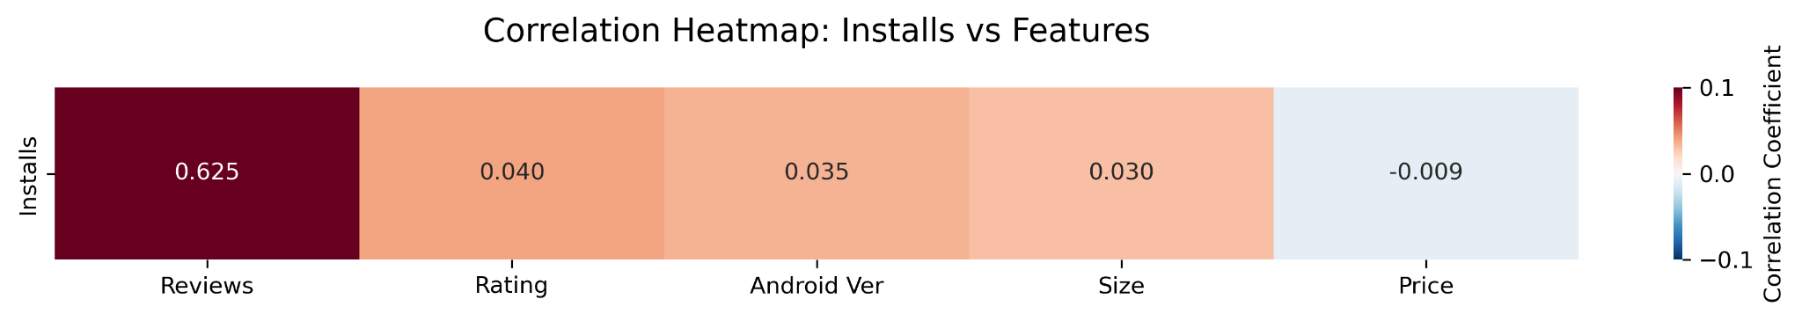
The Big Picture: Correlation Heatmap
heatmap of correlations of ‘numerical’ columns
no. of reviews has a strong positive correlation
price has a weak negative correlation; why weak?
why are the others weakly positively correlated? is there something more going on?
Notes:
does not cover things like category and content rating because those are classes, not numbers

Slide 11
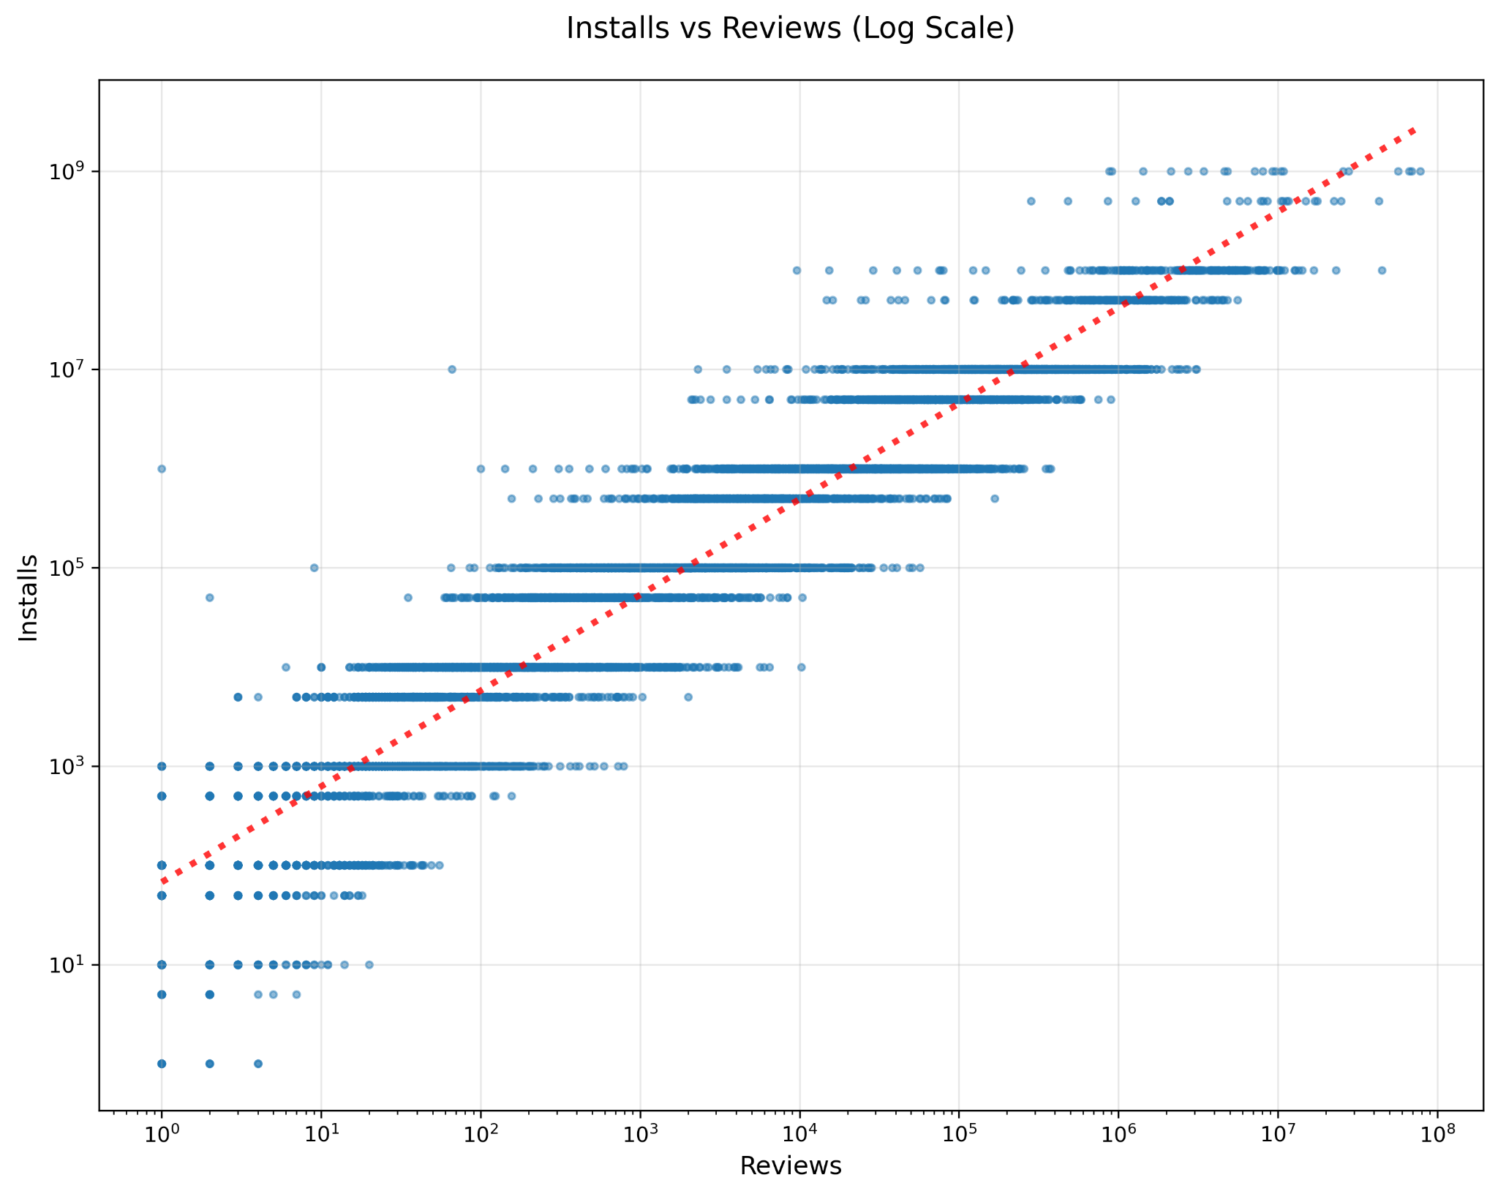
Number of Reviews
log-log plot ⇒ exponential relationship
note: flat lines, not cluster of dots, is a consequence of the dataset

Slide 12
Insights
no. of reviews has an exponential relationship with no. of installs.
social proof! people trust apps that others have reviewed

Slide 13
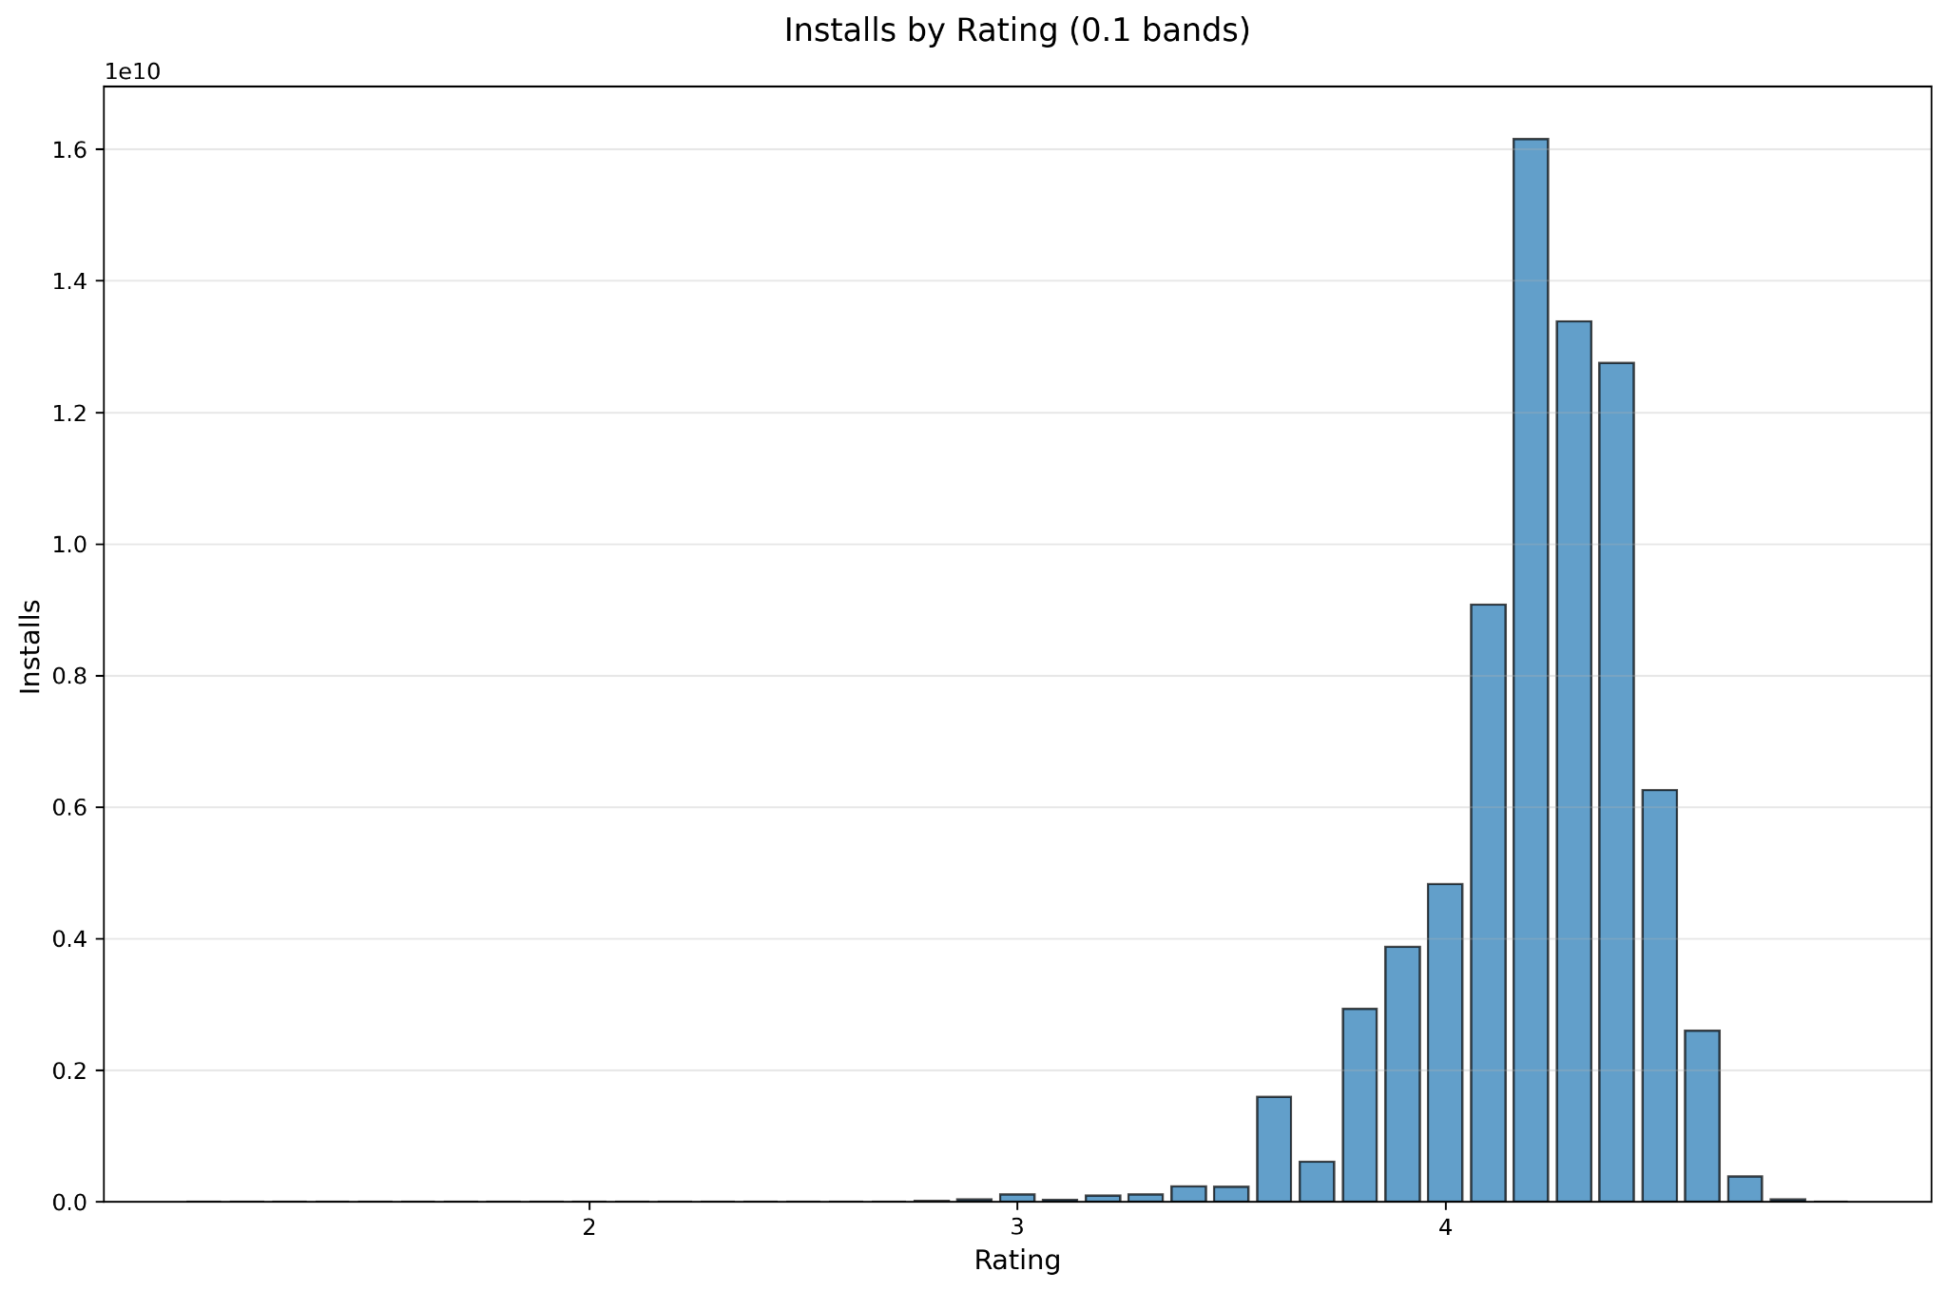
Star-Rating
the higher the installs, the less likely a 5 star rating!

Slide 14
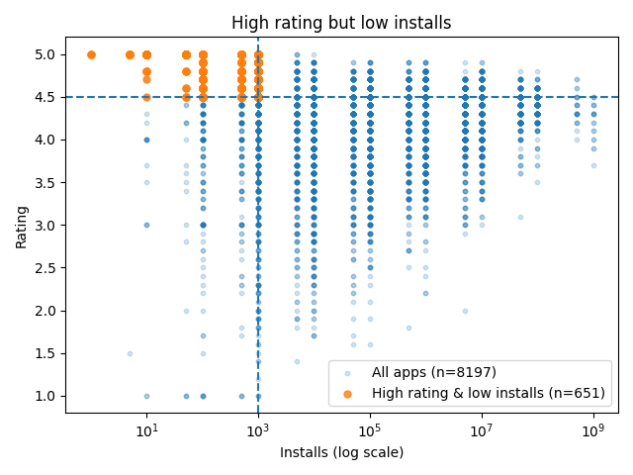
Star-Rating
4 quadrants : high/low installs and high/low ratings
the orange quadrant raises the question: if rating is high but installs are low, maybe it is because the app is new?

Slide 15
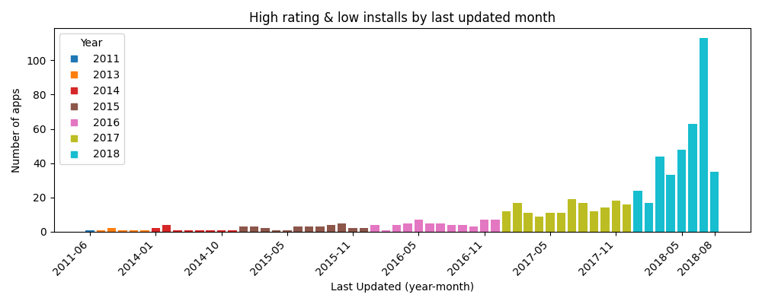
Star-Rating
answer: yes!

Slide 16
Insights
no. of reviews has an exponential relationship with no. of installs.
if the app is new, you want a 5-stars. if it’s been around for a while, 4.2-4.3 is the sweet spot
as an app gets more and more installs, there will always be some haters

Slide 17
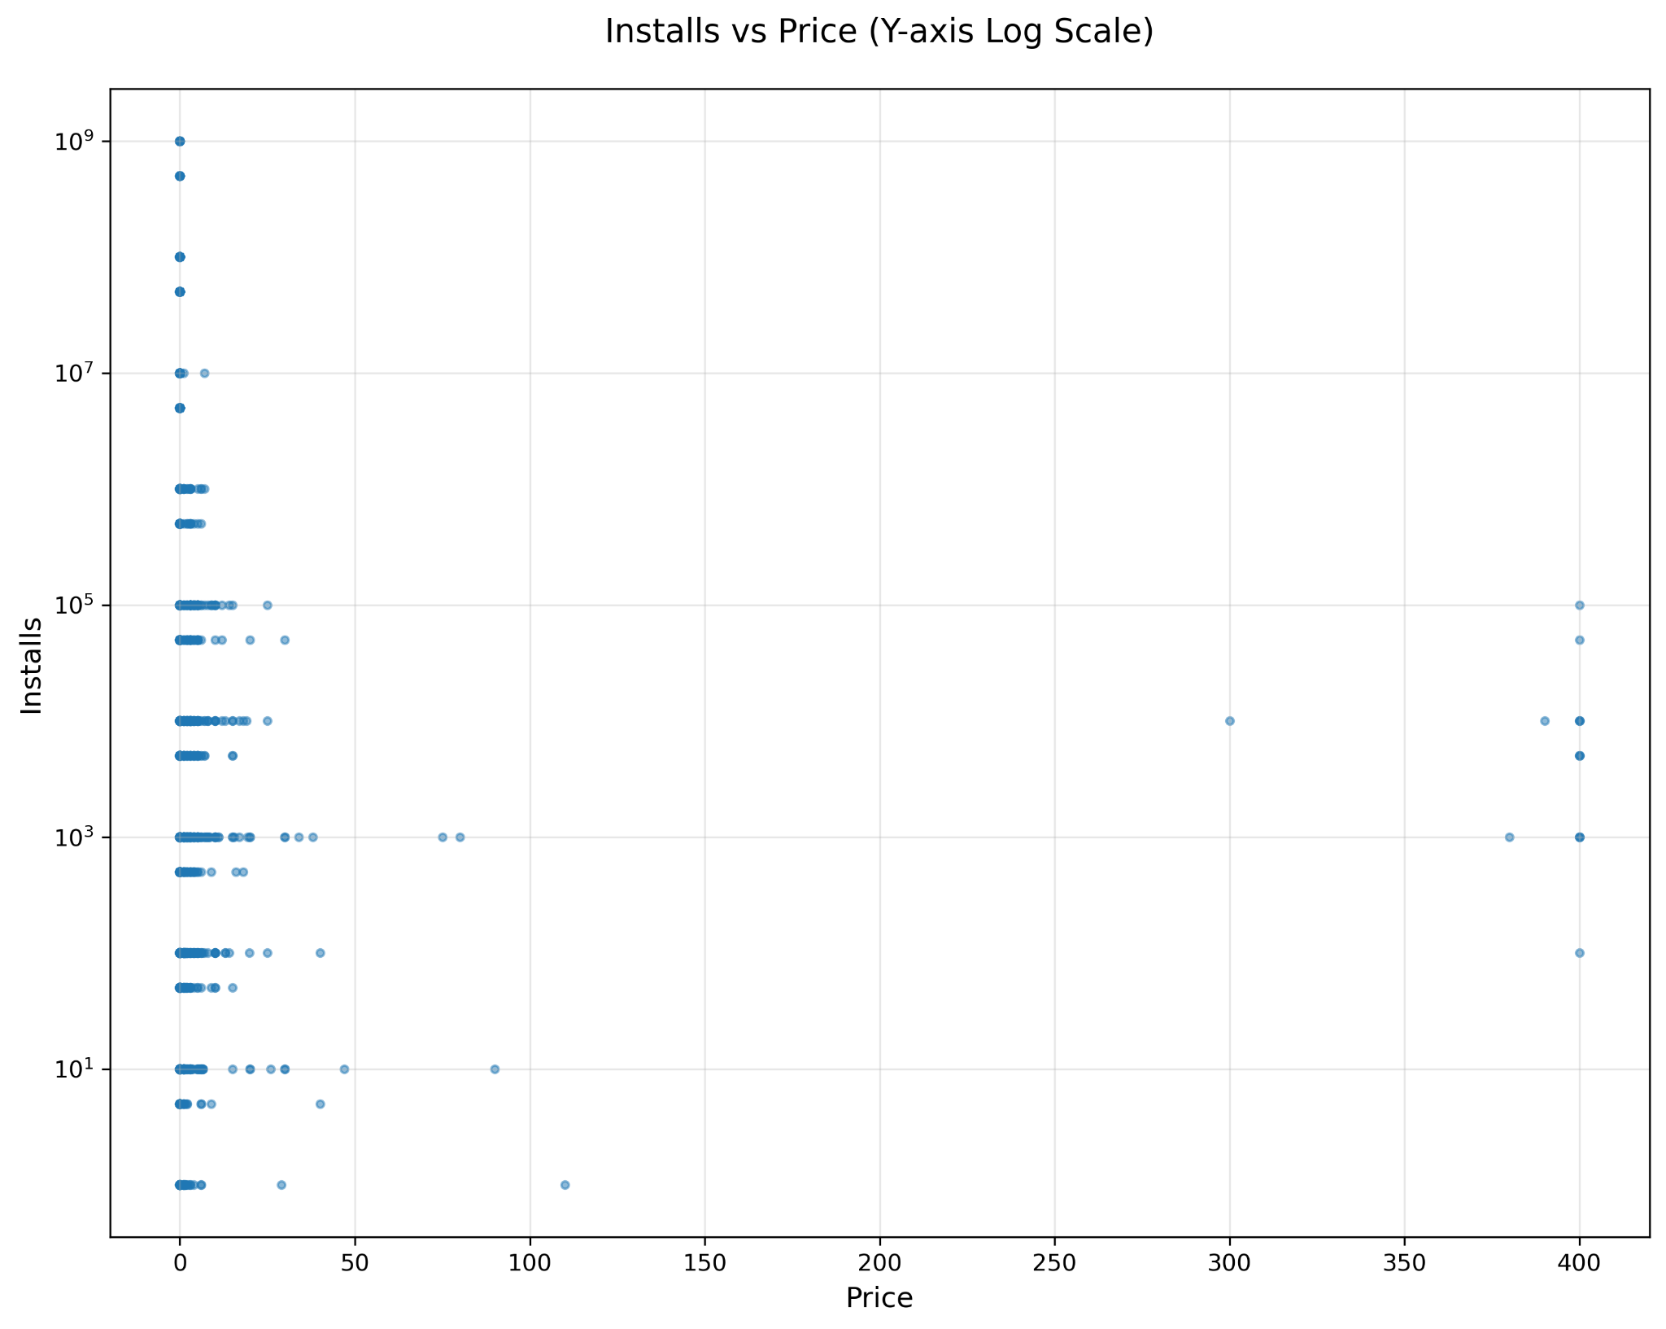
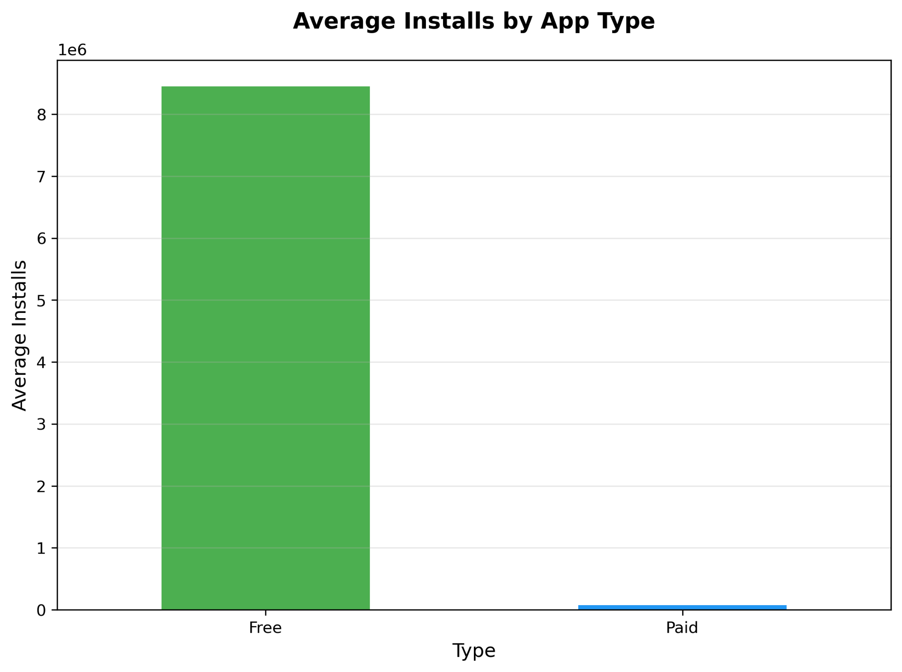
Price
people like free apps, for the most part …

Slide 18
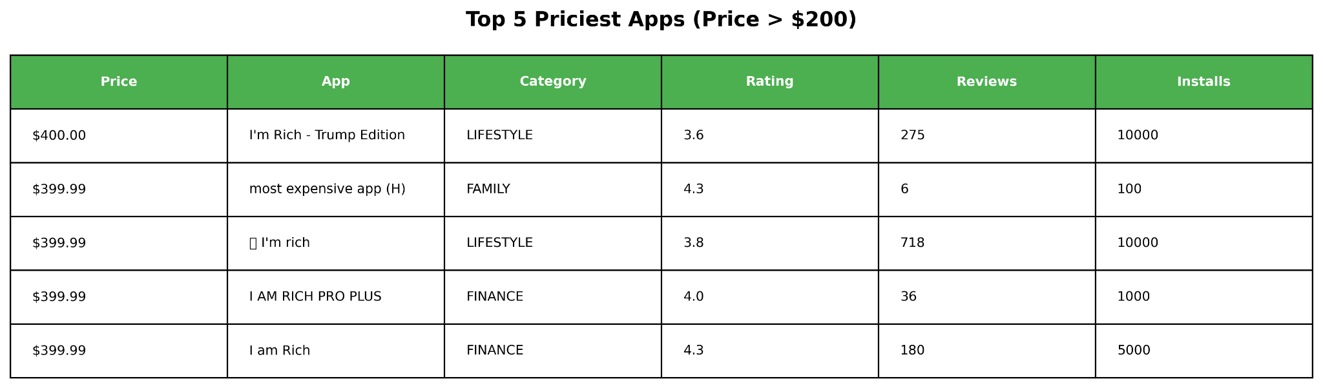
Price
… but with some interesting exceptions!

Slide 19
Insights
no. of reviews has an exponential relationship with no. of installs.
if the app is new, you want a 5-stars. if it has been around for a while, 4.2-4.3 is the sweet spot
free apps clearly do much better (with a few interesting exceptions).
how does that help marketers trying to get an app to make money? likely, ads
outlier: gambling & the associated poor judgement

Slide 20
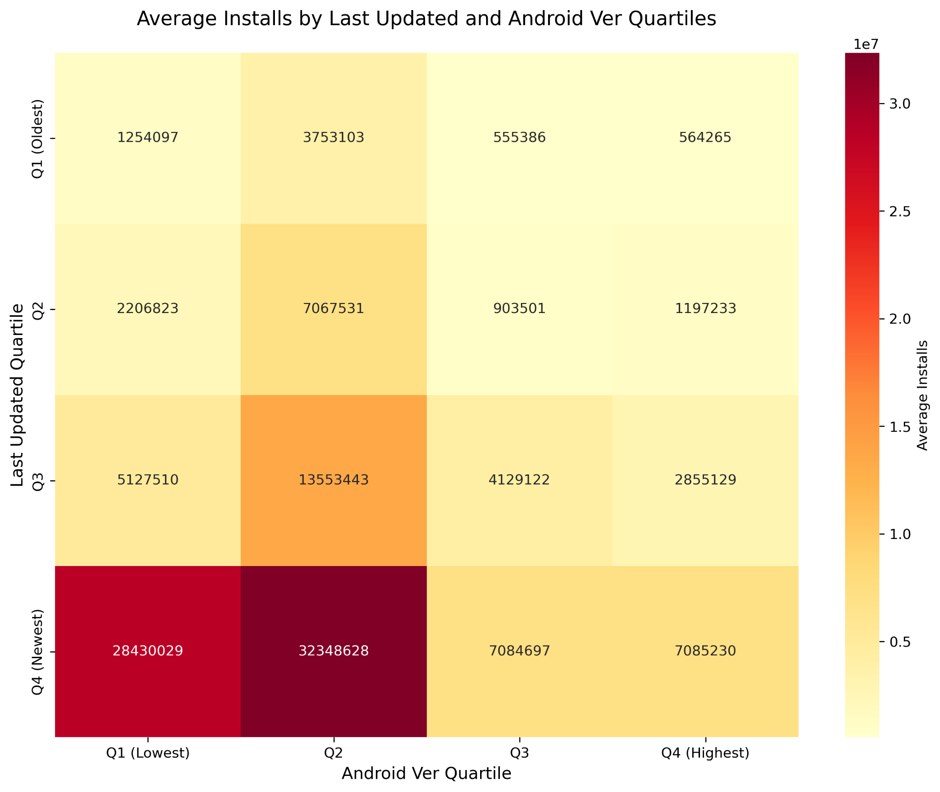
Developer Activity

Slide 21
Insights
no. of reviews has an exponential relationship with no. of installs.
if the app is new, you want a 5-stars. if it has been around for a while, 4.2-4.3 is the sweet spot
free apps clearly do much better (with a few interesting exceptions).
apps well maintained by developers tend to do much better.
incorporating user feedback (gained from reviews)

Slide 22
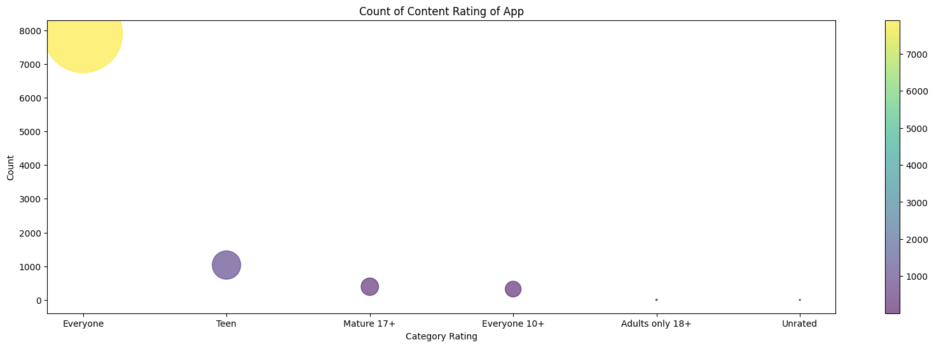
Content Rating
most apps are rated for Everyone
but…

Slide 23
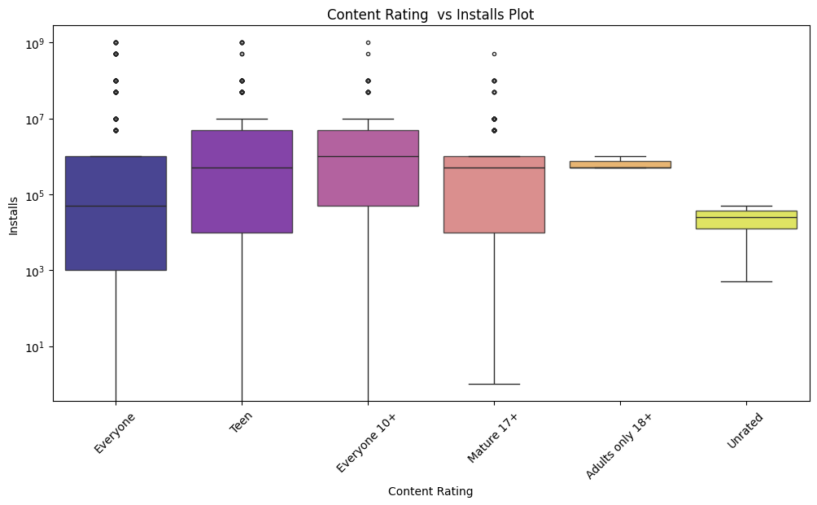
Content Rating
… targeting a demographic is a better strategy!

Slide 24
Insights
no. of reviews has an exponential relationship with no. of installs.
if the app is new, you want a 5-stars. if it has been around for a while, 4.2-4.3 is the sweet spot
free apps clearly do much better (with a few interesting exceptions).
apps well maintained by developers tend to do much better.
it is better to target, in your marketing, a particular demographic

Slide 25
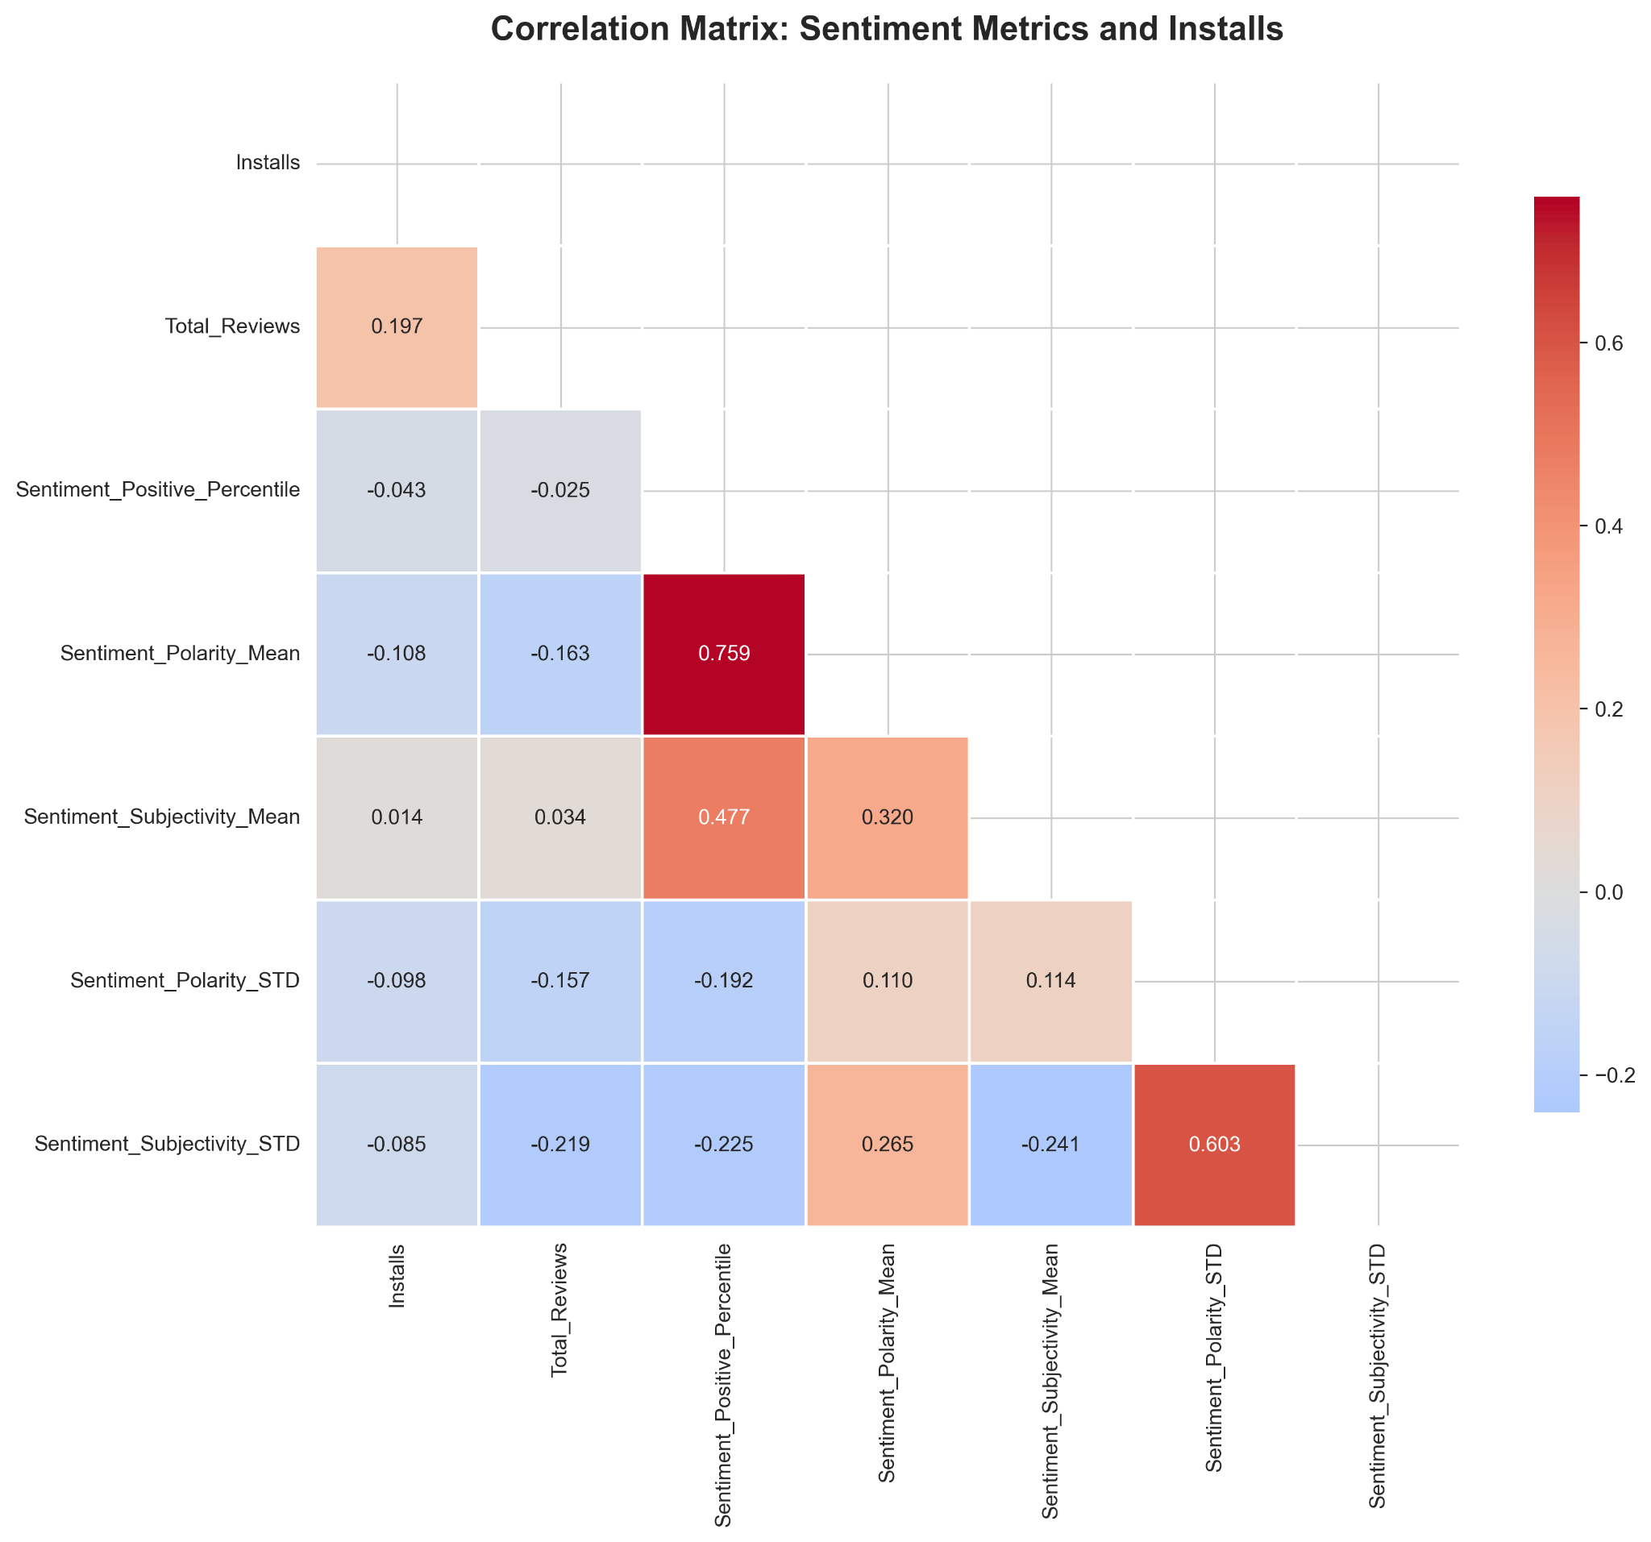
Sentiment

Slide 26
Insights
no. of reviews has an exponential relationship with no. of installs.
if the app is new, you want a 5-stars. if it has been around for a while, 4.2-4.3 is the sweet spot
free apps clearly do much better (with a few interesting exceptions).
apps well maintained by developers tend to do much better.
it is better to target, in your marketing, a particular demographic
just because a lot of apps of a certain type are being made, doesn’t mean you’ll do well
sentiment doesn’t correlate much with number of installs
likely reason: this dataset is not time series, and further, have much lower no. of sentiment samples. which could mean that an app which initially got negative reviews improved over time by incorporating feedback.

Slide 27
Agenda
About the dataset
Cleanup
Dataset Analysis deep dive
Prediction Model
Conclusion

Slide 28
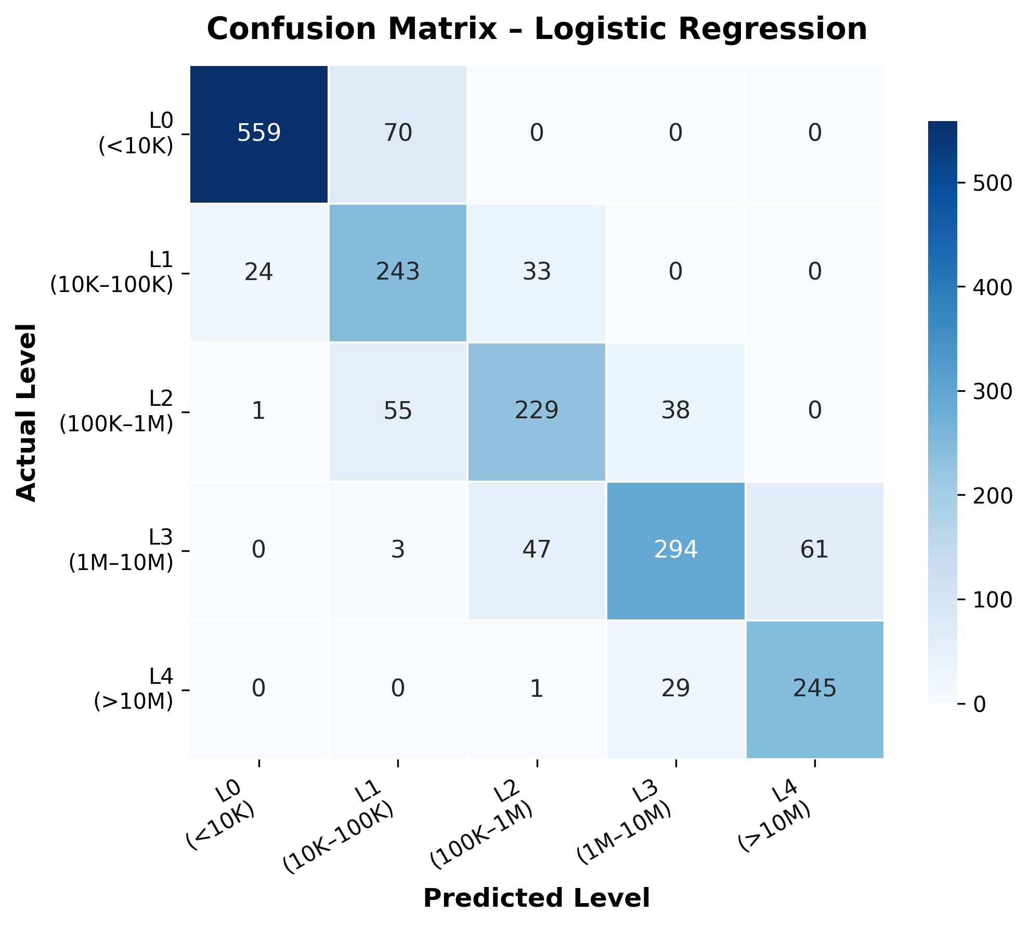
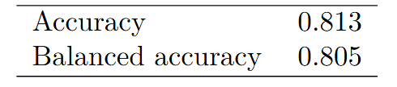
Prediction Model
Notes:
Accuracy = (TP + TN) / (no. of samples)) = (TP + TN) / (TP + TN + FP + FN) balanced accuracy = (sensitivity + specificity)/2 Sensitivity = TP / (TP + FN) → The proportion of actual positive cases that were correctly predicted as positive. Specificity = TN / (TN + FP) → The proportion of actual negative cases that were correctly predicted as negative. 1.Overall performance is strong. ( Accuracy = 0.81)
2.Most of the mistakes are just one level off. example: in confusion matrix L2 app is usually misclassified as L1 or L3, not as L0 or L4.
3.Number of reviews is the dominant factor in high installs.
4.Free apps and certain categories boost installs
5. Rating is less critical once reviews are high. 6.Being free and belonging to categories like video players, photography... increases the probability of high installs.

Slide 29
Agenda
About the dataset
Cleanup
Dataset Analysis deep dive
Prediction Model
Conclusion

Slide 30
Conclusions
Things that you should focus on if you want your app to do well:
No. of reviews
price (free apps)
targeted demographic
developer activity
star rating (depends on app age)
Logistic regression based model with ~80% accuracy

Slide 31
Thank you!

Slide 32
Backup

Slide 33
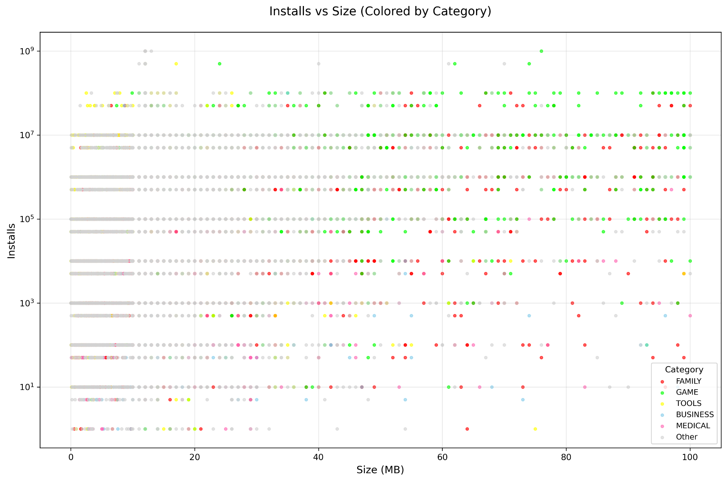
Size
some categories just have large-sized apps (e.g. games)

Slide 34
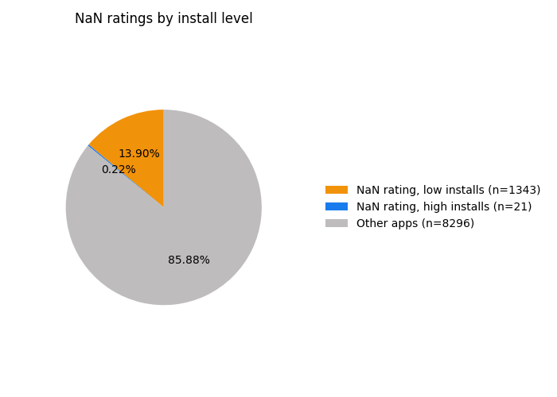
Star-Rating
some ratings in the data are NaN (treat as zero). most are for low installs (expected). NaN for high installs are outliers; ignore
the higher the installs, the less likely a 5 star rating!

Slide 35
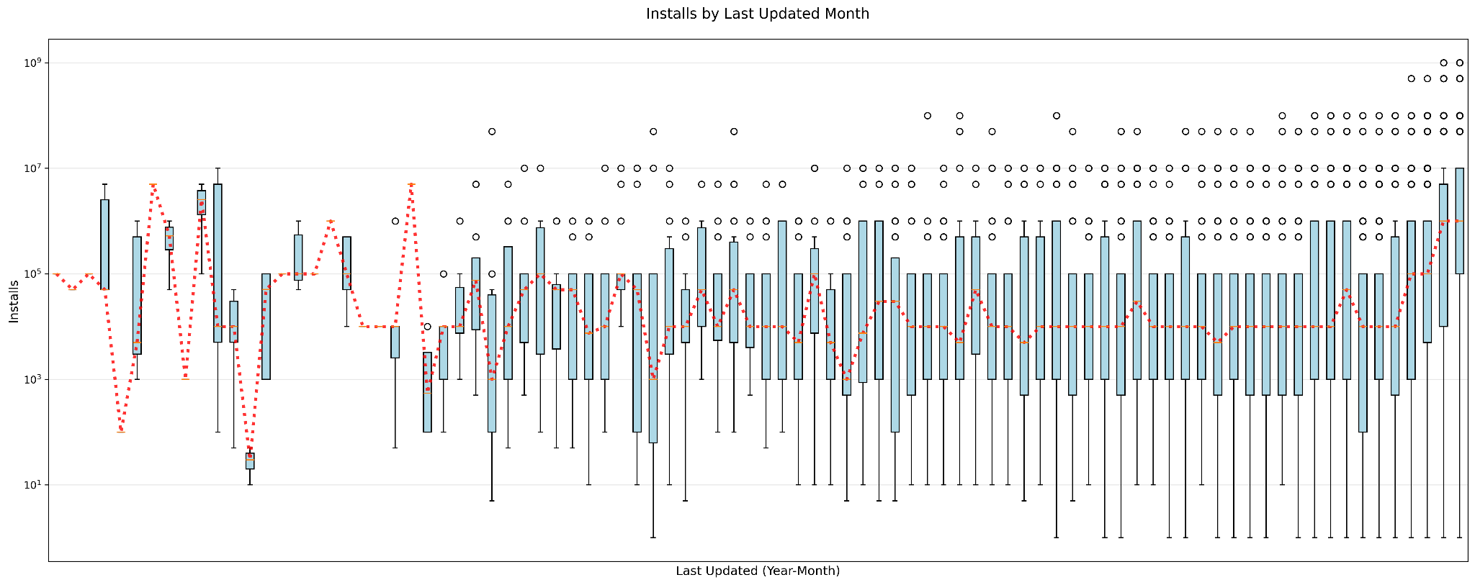
Developer Activity

Slide 36
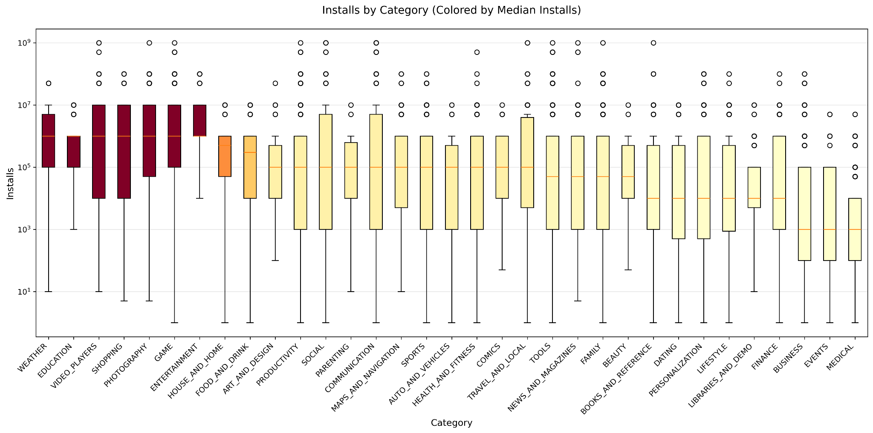
Category

Slide 37
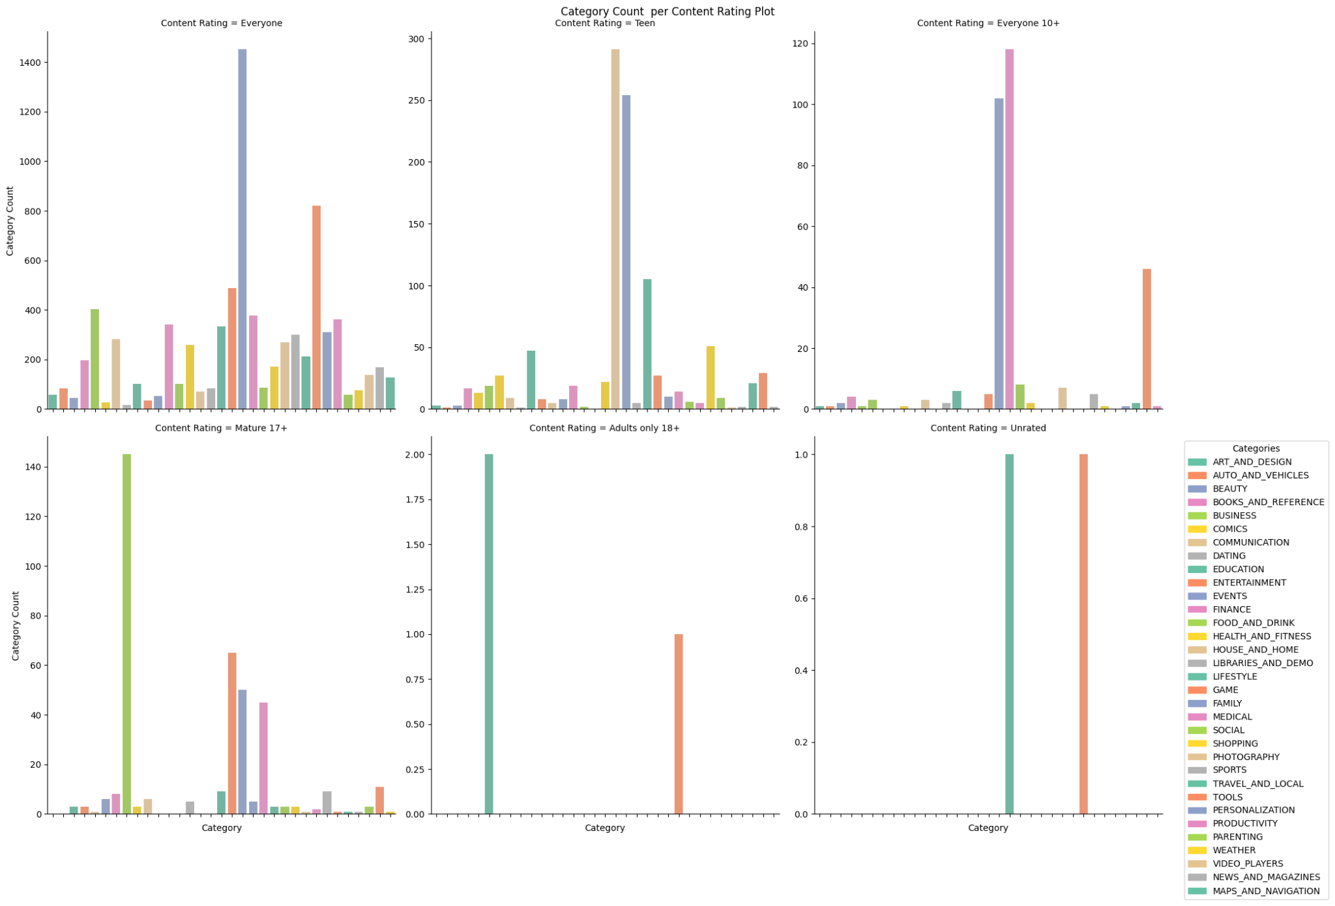
Content Rating

Slide 38
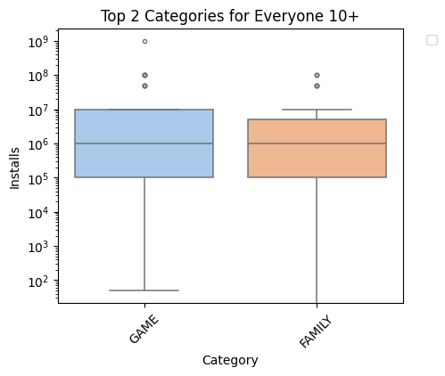
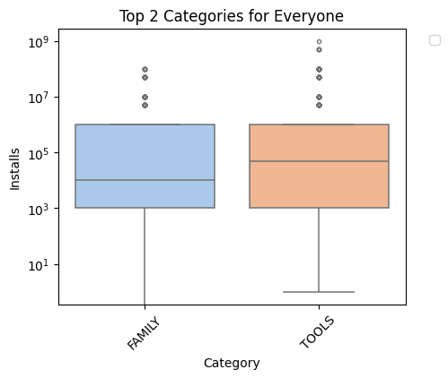
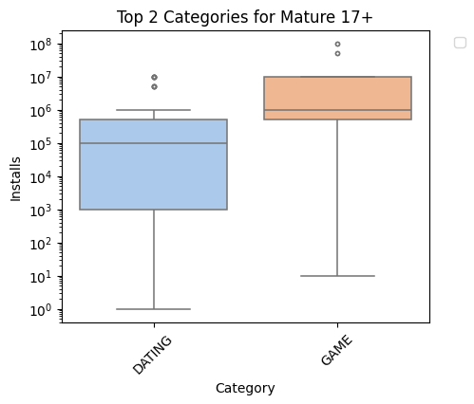
Content Rating

Slide 39
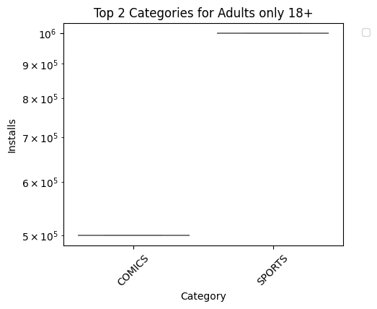
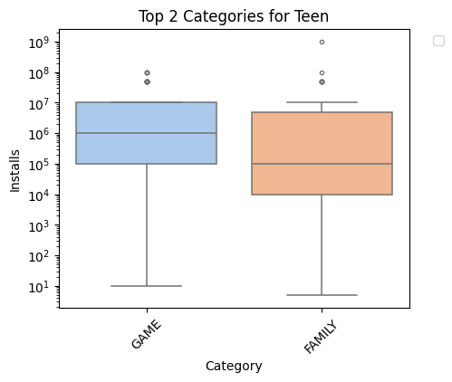
Content Rating

Slide 40
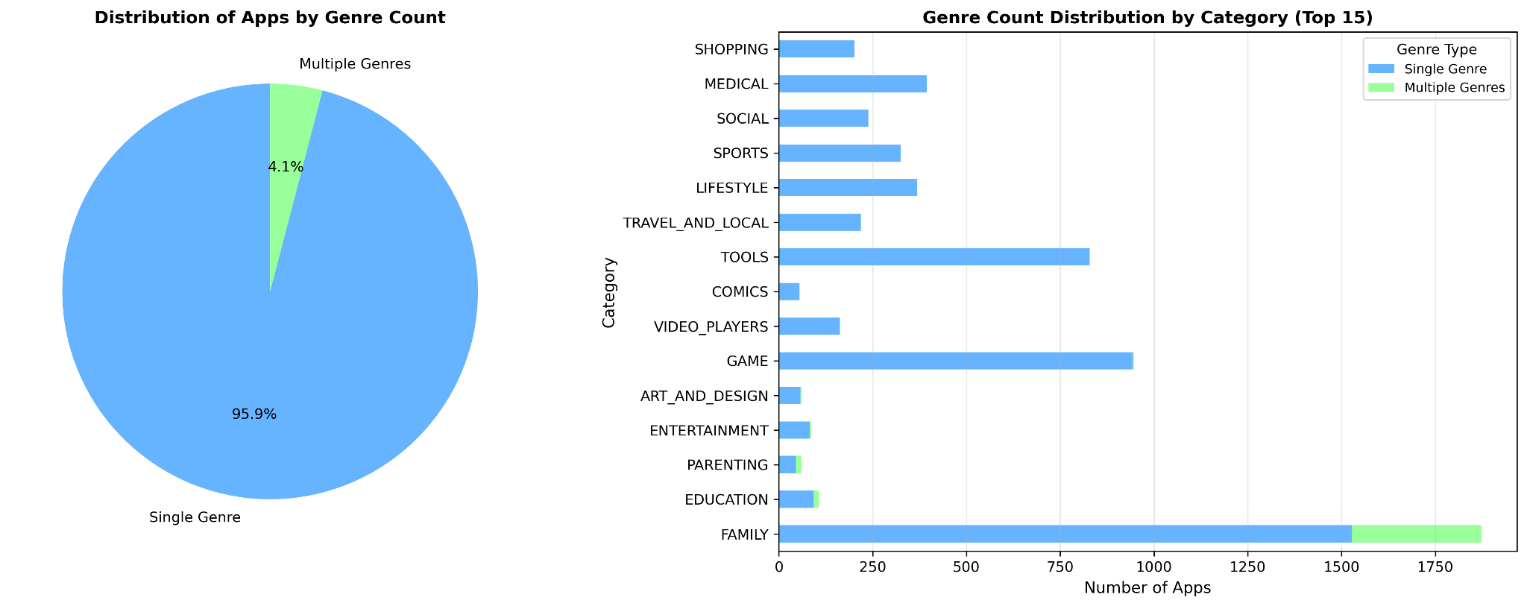
Genres
some categories/genres have a lot of apps…

Slide 41
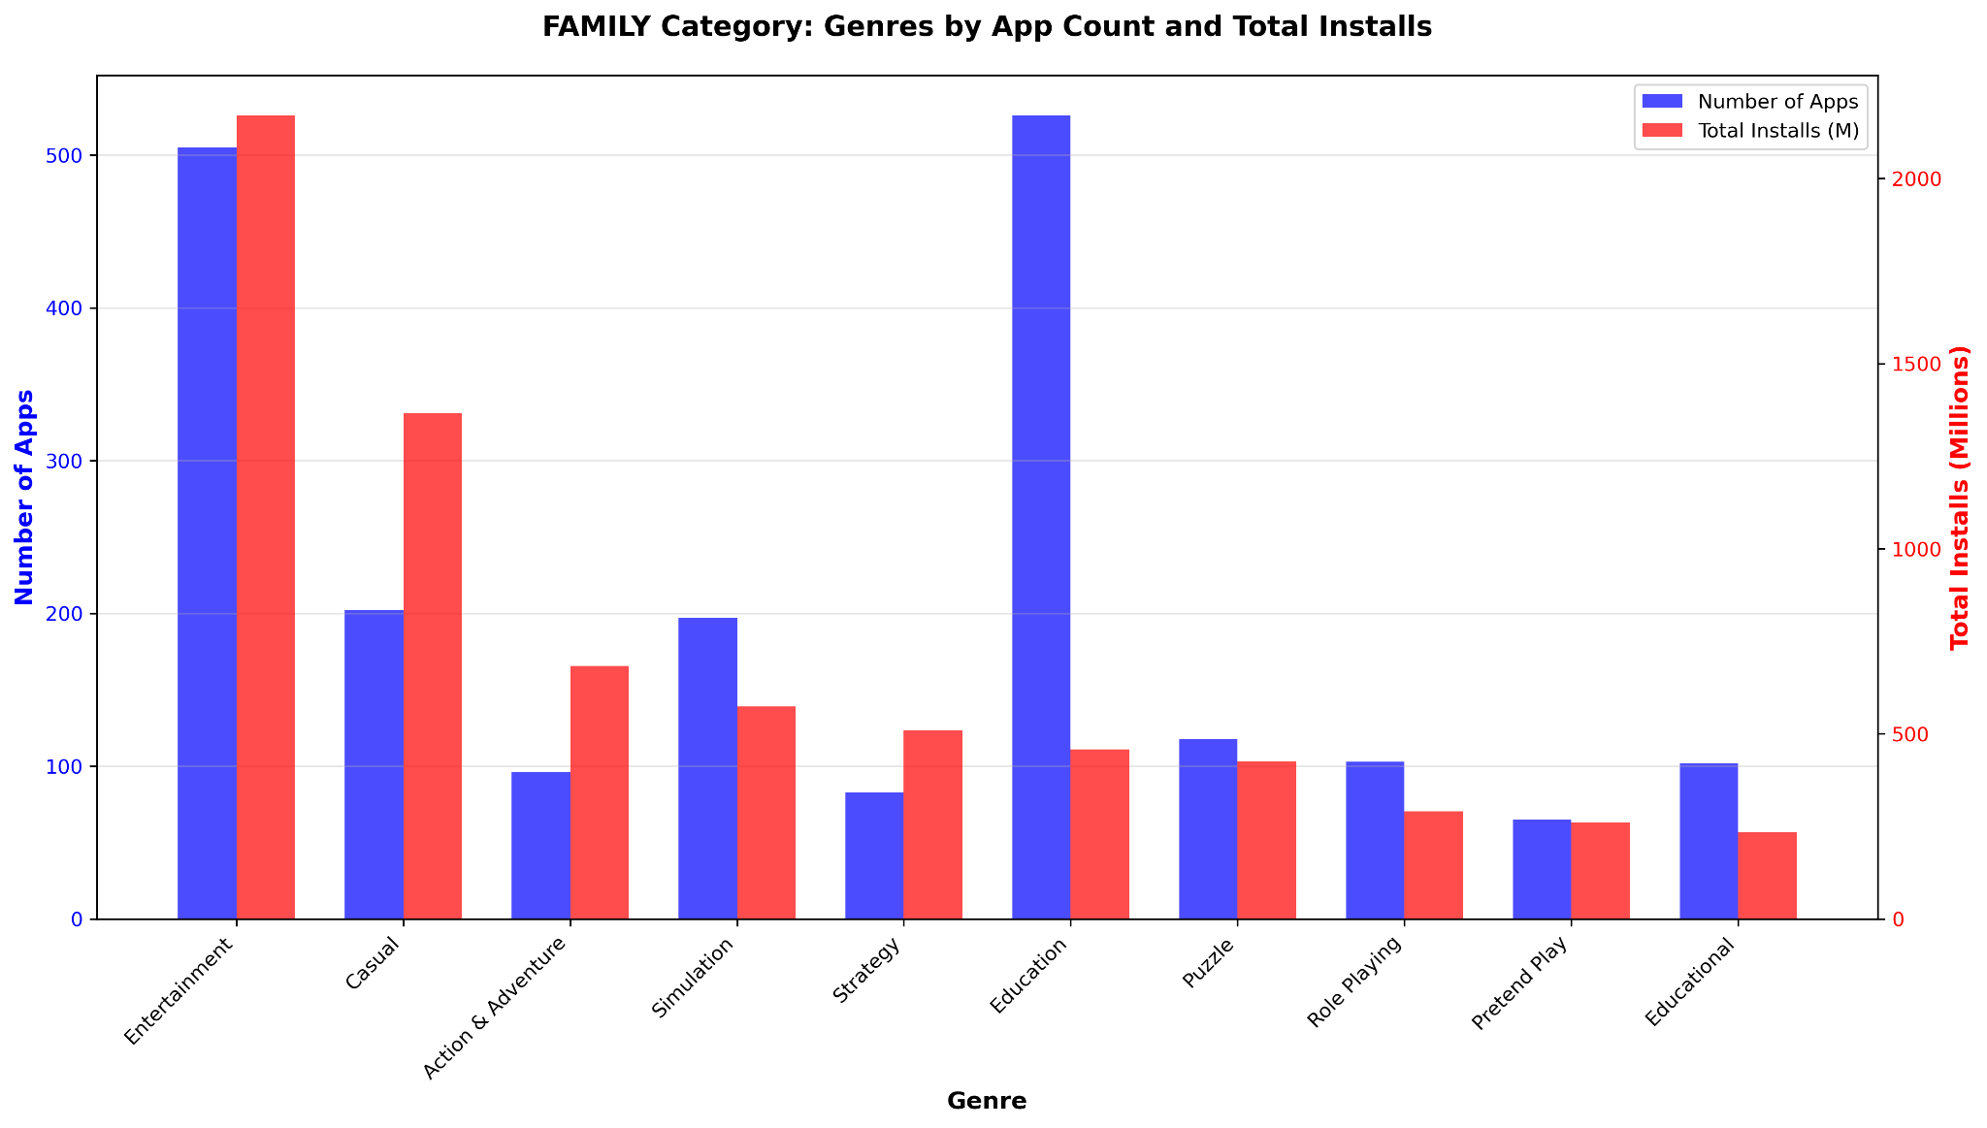
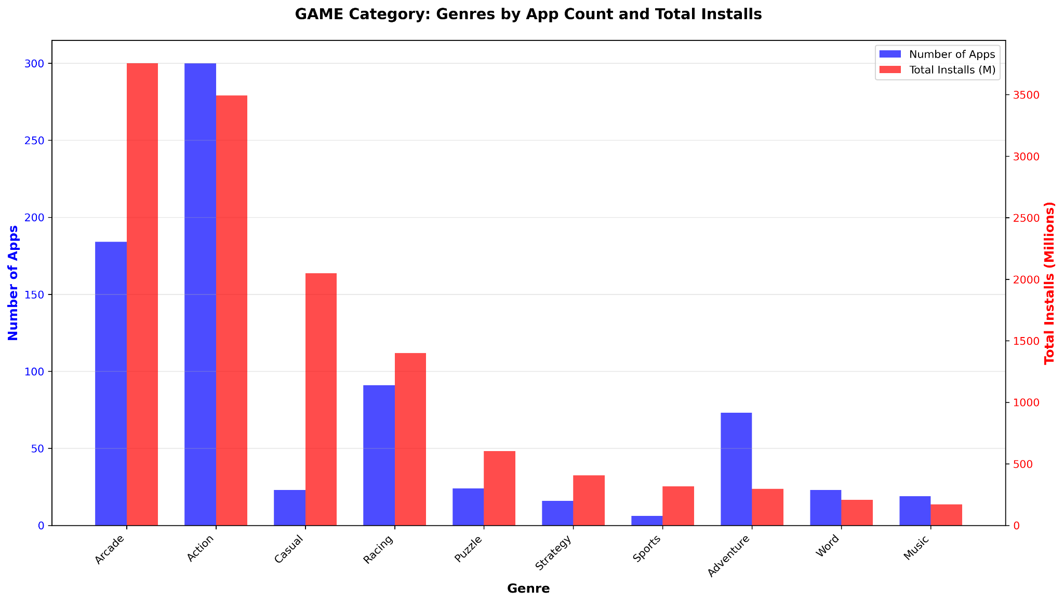
Genres
… but that doesn’t really reflect in the number of installs!

Slide 42
Genres
genre having a lot of apps doesn’t reflect in the number of installs!

Slide 43
Insights
no. of reviews has an exponential relationship with no. of installs.
if the app is new, you want a 5-stars. if it has been around for a while, 4.2-4.3 is the sweet spot
free apps clearly do much better (with a few interesting exceptions).
apps well maintained by developers tend to do much better.
it is better to target, in your marketing, a particular demographic
just because a lot of apps of a certain type are being made, doesn’t mean you’ll do well
don’t follow the rat race/try to break into an existing market. a lot of app markets are winner-take-all

Slide 44
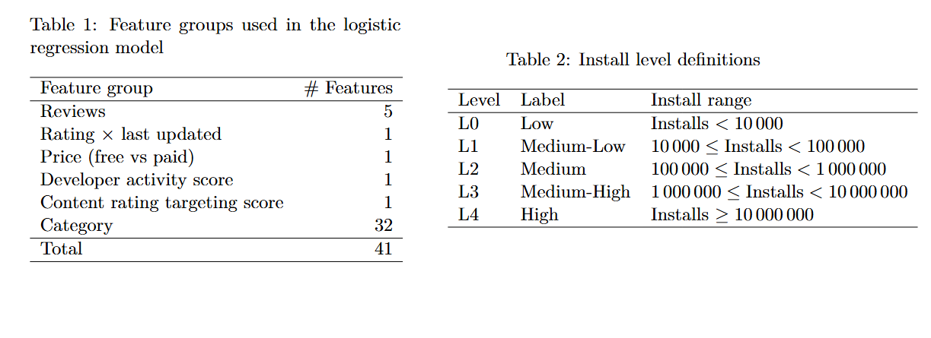
Prediction Model

Slide 45
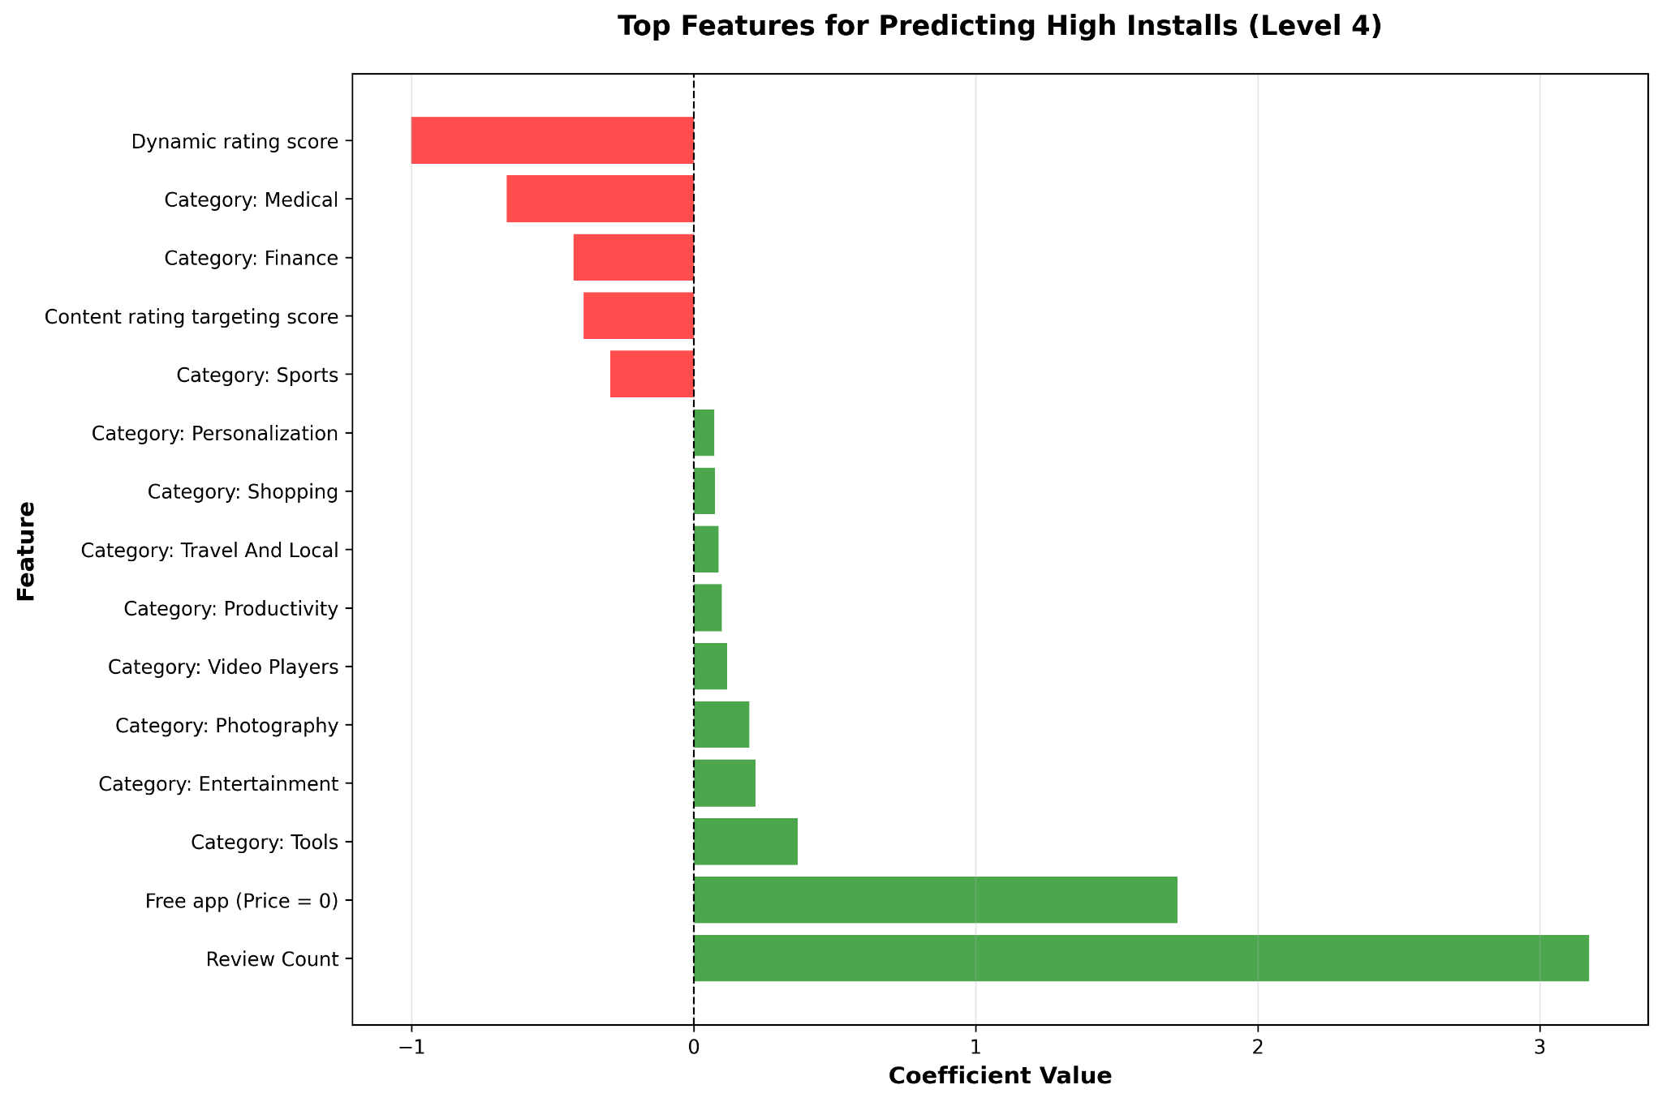
Prediction Model

